Slide 1
Credit Memo Training Guide 2023

Slide 2
Agenda
Scope of Products and Documents
Demo
Credit Memos

Slide 3
Credit Memo Call Outs
Credit Memos should be used when Stryker needs to return defective product. Once the product is returned the supplier will need to submit a credit memo to Stryker.
A Credit Memo should be created against the Returns PO sent to supplier account from Stryker.
Credit Memos can be used for rebilling purposes as well.
NOTE: If you have invoiced but changes are needed to the previously submitted ASN, a credit memo is used to cancel the invoice and ultimately place the quantities as not invoiced back into

Slide 4
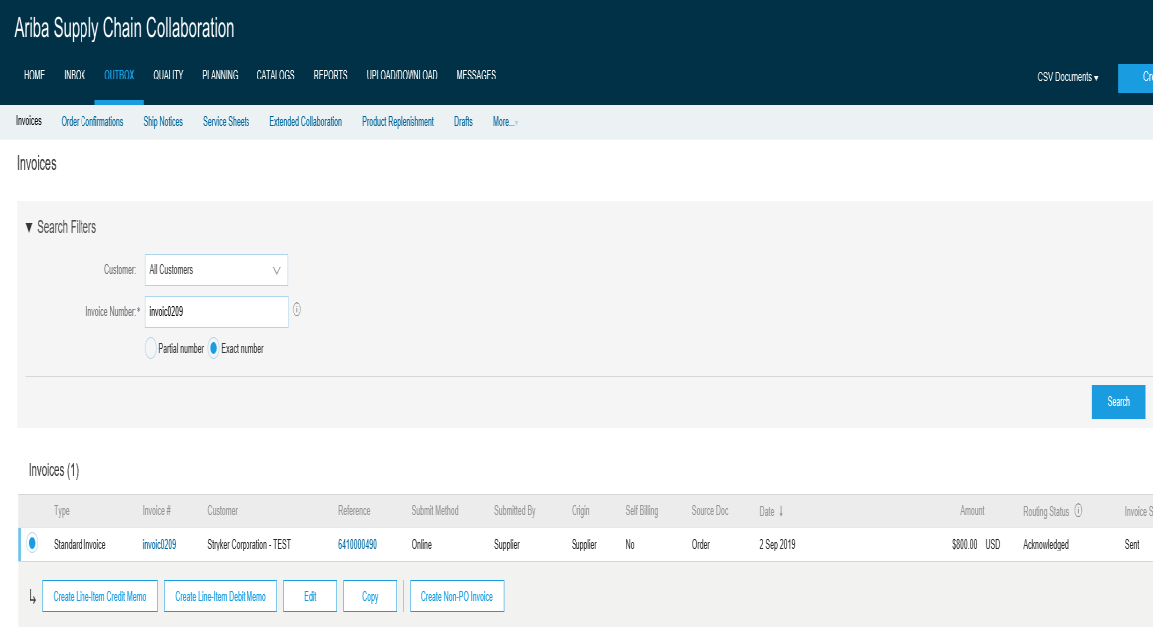
Credit Memo Creation
1.Click Outbox tab
2.Select bubble next to
1
previously submitted
Invoice number
3.Click Create Line Item
Credit Memo
2
3
©2016 SAP SE or an SAP affiliate company. All rights reserved. Customer 2

Slide 5
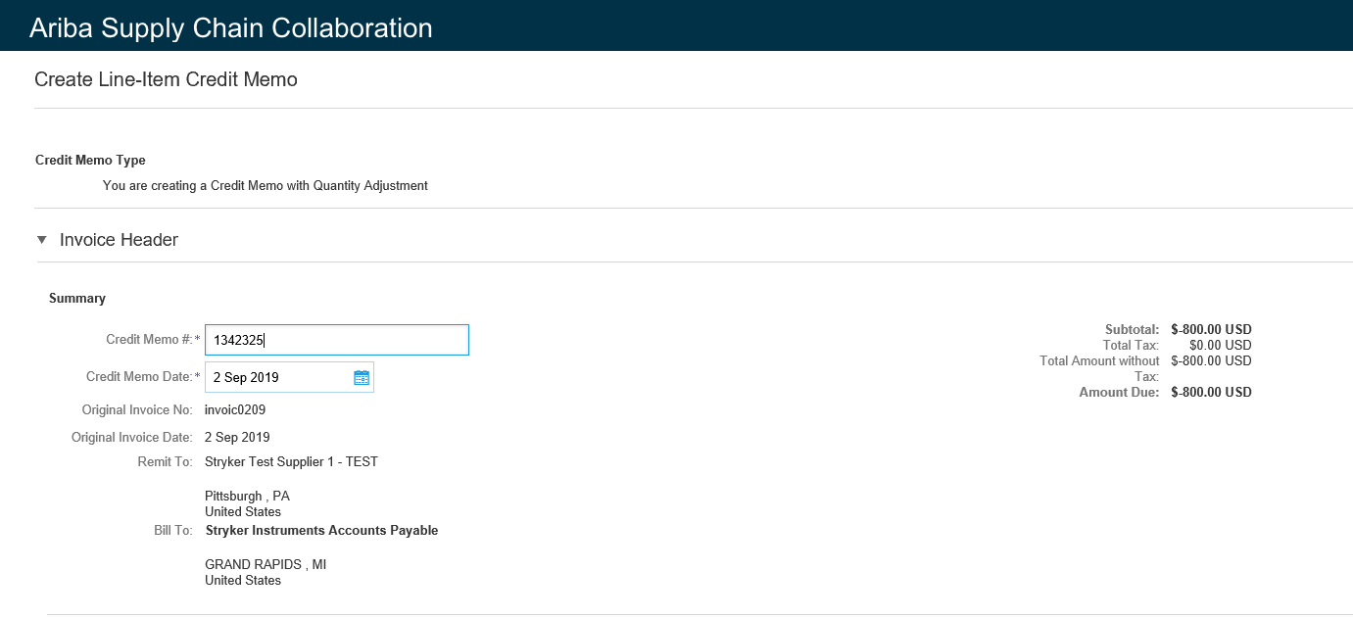
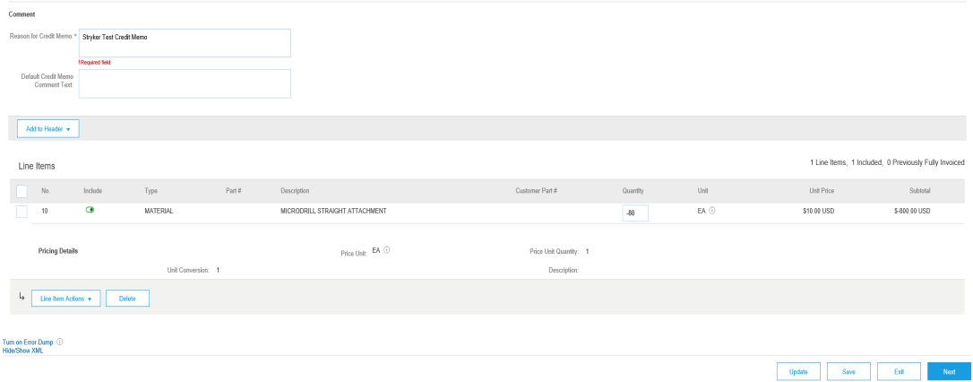
Credit Memo Creation
1.Insert Credit Memo number
2.Insert Reason for Credit
Memo
3.All Line item info from
1
previously submitted
invoice line item info auto
populates into Credit
Memo creation interface
1.Quantity will be negative
2
2.Unit Price will be positive
3.Subtotal will be negative value to
signal Credit for line item
4.Click Next
3
4
©2016 SAP SE or an SAP affiliate company. All rights reserved. Customer 3

Slide 6
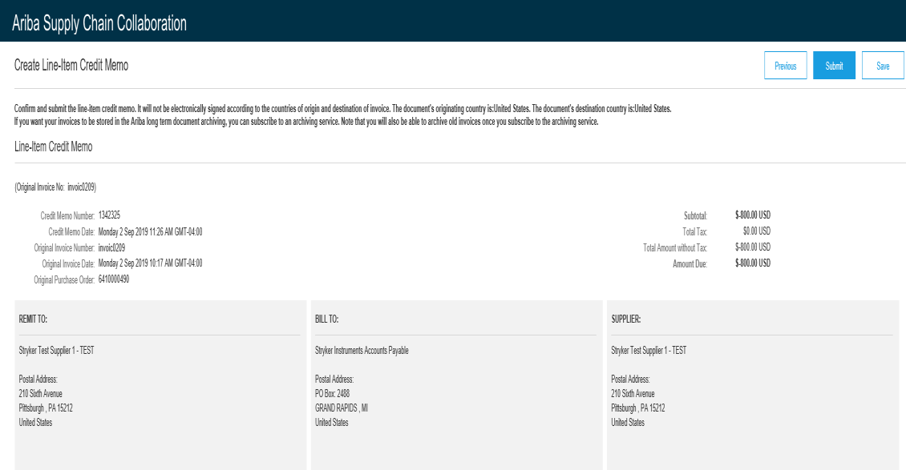
Credit Memo Creation
1.Click submit button to
send Credit Memo to
Stryker
1
©2016 SAP SE or an SAP affiliate company. All rights reserved. Customer 4

Slide 7
Thank you for joining the Ariba Network!

